Slide 1


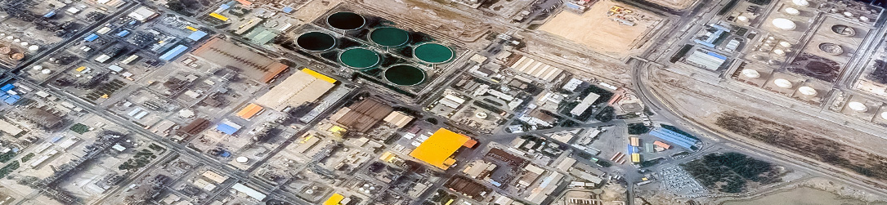
Iran's Petrochemical Downstream: A gateway towards value creation
Afsaneh Shafiei
September 2017

Slide 2
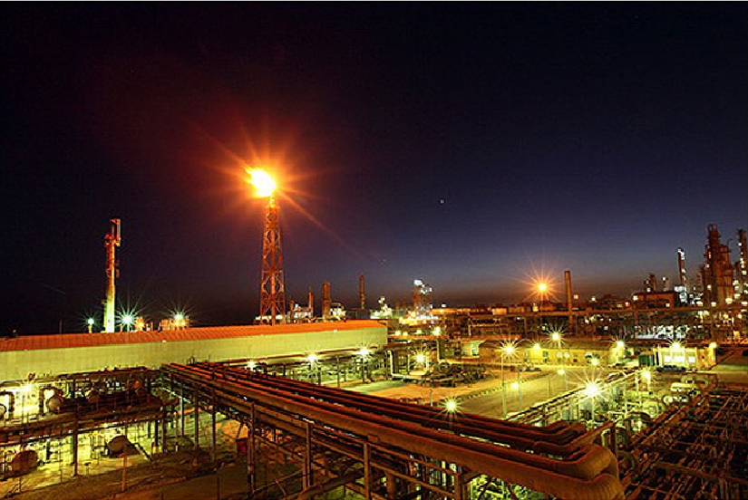
Contents:
1- Petrochemical Industry in Iran
2- Petrochemical value chain in Iran
3- Main Drivers of the petrochemical Industry in Iran
4- future projects
5- Concluding Remarks and Cooperation Fields

Slide 3
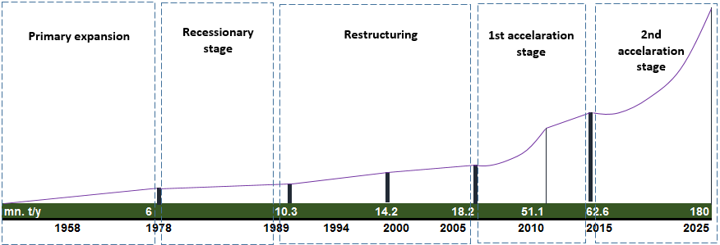
1. Petrochemical Industry in Iran
1-1. Evolutionary trend
Accelerating Trend
capacity
time
West Ethylene
Pipeline
Petrochemical products trade in IME (Iran Mercantile Exchange)
Rebuilding plants
New grassroots facilities
2 special economic zones
Fertilizer Authority
NPC establishment
Privatization policy
new wave of investment (36 projects)

Slide 4
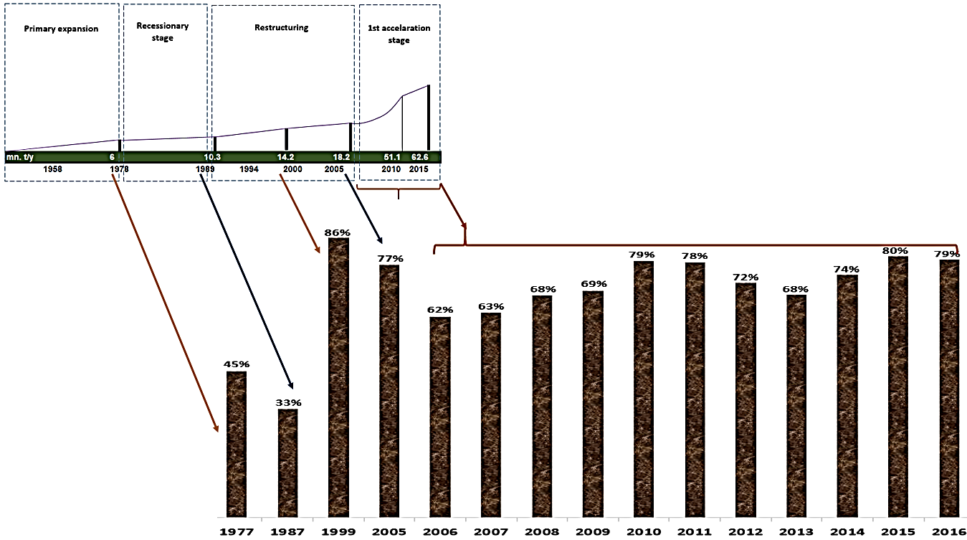
1. Petrochemical Industry in Iran
1-1. Evolutionary trend
Except for the period of sanction pressures (2010-2013) which resulted in low capacity utilization, there had been an improving trend on the way petrochemical productive capacity has been used within recent decade.
Capacity utilization (percent)

Slide 5

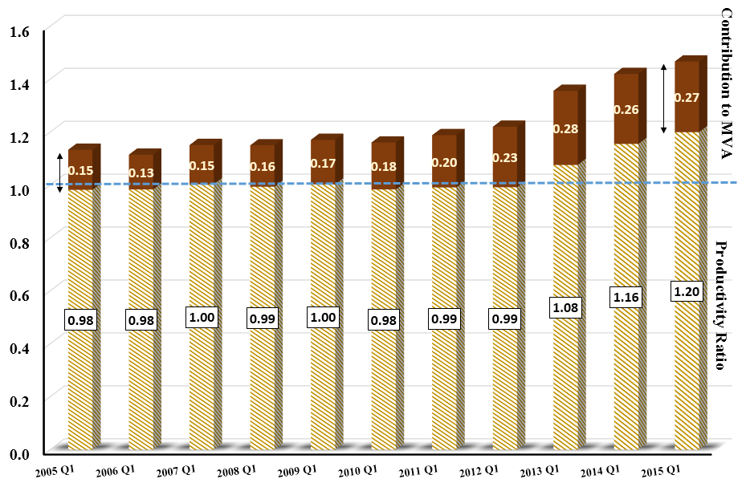
1. Petrochemical Industry in Iran
1-2. Contribution to Iran’s Economy
Increased contribution of Petrochemical activity in Iran (MVA) has been in accordance with the improved productivity ratio compared to the average productive level in the industry sector.
Post-Sanctions era
Productivity Base line

Slide 6
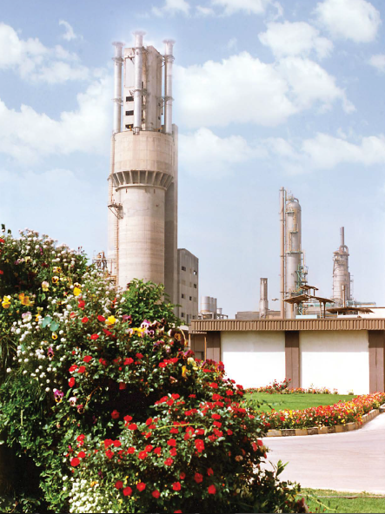
1. Petrochemical Industry in Iran
Petrochemical Industry in Iran:
is rather young and expected to enjoy considerable potentials.
could have much better performance in the absence of Iran’s economic distortions (incl. imposed war and the pressures of economic sanctions).
is going to be the key driver of economic growth and export in Iran; hence is set to be an important target for investors in Iran.

Slide 7
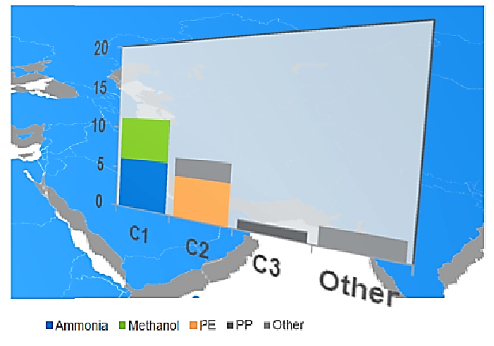
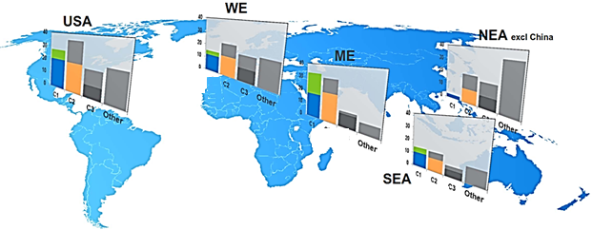
2. Petrochemical Value chain in Iran
While Iran’s petrochemical competitiveness have been centered on gas based processing products, domestic import substitution opportunities exist for C2+ products.
It is targeted to reduce the share of C1/C2 products on behalf of C3s and higher valued products.
Iran
USA
WE
NEA
ME
SEA
Source: Nexant (2017)

Slide 8
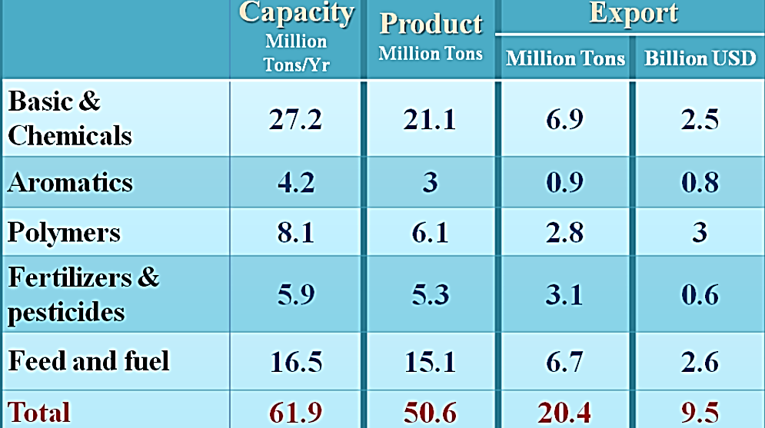
2. Petrochemical Value chain in Iran
Petrochemical Production and Export Combination
Iran’s petrochemical production capacity (upstream and intermediate) has increased by 20 times from 3 million t/y in 1978 to 60 million t/y in 2014 and 61.9 in 2017Q1.
It is currently producing a widely diversified range of petrochemicals including polyethylenes, polypropylenes, PVC, polystyrenes, Acrylonitrile Butadiene Styrene (ABS), polycarbonate, xylenes, styrene and Styrene Butadiene Rubber (SBR), out of which over 4 million tons are presently used in domestic plastic industry.
Source: National Petrochemical Company
Despite recent developments in petrochemical value chain extension, there are still much more latent benefits to be realized.
This makes Iran’s petrochemical downstream as a gateway of value creation for investors.

Slide 9
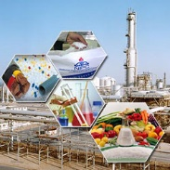
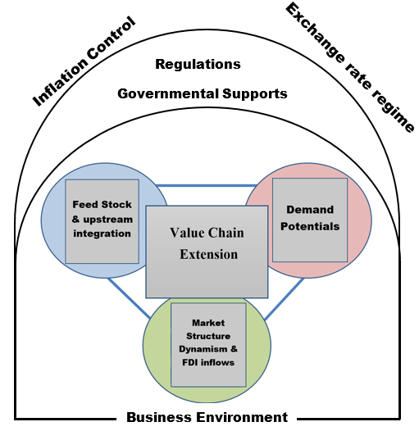
3- Main Drivers of the petrochemical investment in Iran

Slide 10
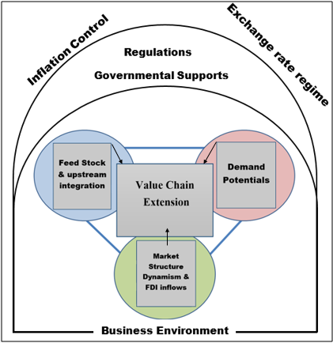
3-1. Market Structure
3- Main Drivers of the petrochemical Industry in Iran
Since 2008, there has been a structural change in Petrochemical market structure towards increasing the contribution of private sector.
Ministry of Petroleum
Transferred companies to non-governmental investors
NPC
20% of shareholding
Regarding production share, there exists competitive market structure in Iran’s petrochemical industry:
top 6 producers (out of 53) account for about 50 percent of total production.
The corresponding contribution of top 6 producers amounts to 45.5 percent of total export as well as 42.1 percent of domestic sale.
NPC’s owned companies (7)
Persian Gulf Pet. Complex (15 subsidiaries)
New projects
20 percent of state-owned share
80 percent
location
PETZON
19
PSEEZ
14
others
18

Slide 11
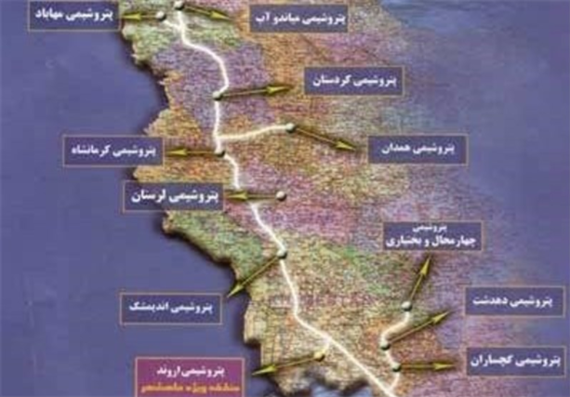
3-2. Feedstock condition
3- Main Drivers of the petrochemical Industry in Iran
With the completion of West Ethylene Pipeline project (phases 1&2), which brings feedstock from South Pars gas field in Persian Gulf waters, feedstock supply have increased by 150 percent (from 400,000 to to 1 million tonne).
10. Mahabad
11. Miandoab
9. Kordestan
7. Kermanshah
8. Hamedan
6. Lorestan
5. Bakhtiari
3. Andimeshk
4. Dehdasht
Source: Central Bank of Iran
1.Arvand
2. Ghachsaran
Petrochemical units in Iran and Saudi Arabia enjoy the most advantageous Gas Price conditions.
Map of 2,650-km West Ethylene Pipeline project
Source: National Petrochemical Company

Slide 12
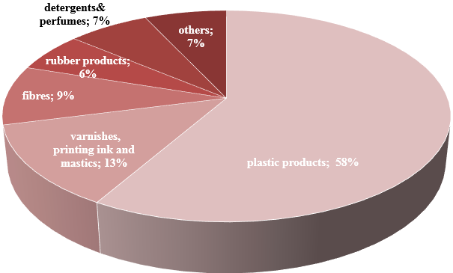
3-3. Iran petrochemical export and domestic demand
3- Main Drivers of the petrochemical Industry in Iran
Downstream Projects by manufacturing activity (2017)
Considerable demand potential regarding downstream projects in Iran’s economy.
The most attractive ones are:
Plastic products
Painting ink
Fibers
Rubber products
Detergents and perfumes
Source: Ministry of Industry, Mine and Trade

Slide 13
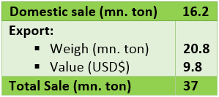
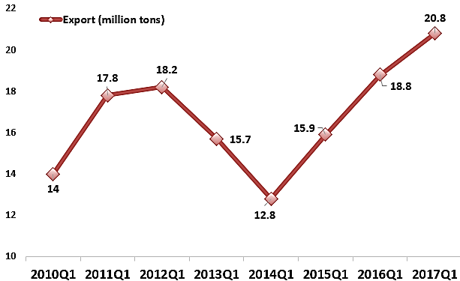
Iran’s Petrochemical Market Sales (2017Q1)
3- Main Drivers of the petrochemical Industry in Iran
3-3. Demand Condition
Iran’s Petrochemical Exports (2010Q1-2017Q1)
Source: NPC
Petrochemical export account for a total of 54 percent of Iran’s petrochemical sales in 2017Q1.
Source: NPC

Slide 14
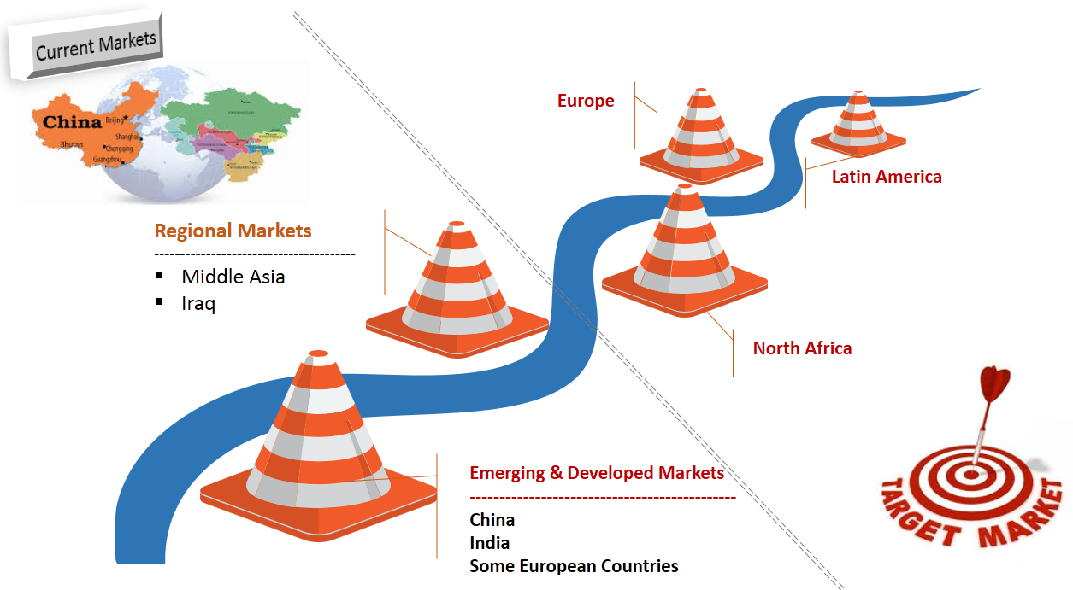
3-3. Iran petrochemical export and domestic demand/ cont.
3- Main Drivers of the petrochemical Industry in Iran

Slide 15
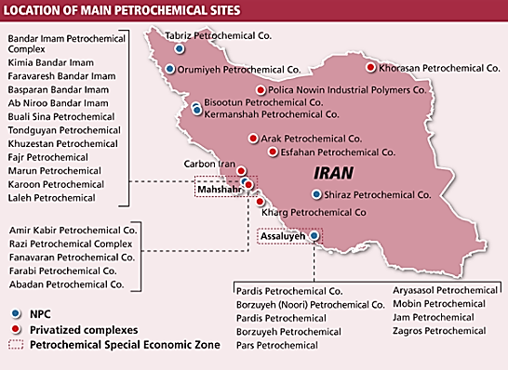
3-4. Governmental regulations and supports
3- Main Drivers of the petrochemical Industry in Iran
Allocating subsidized gas within a unit mechanism of feedstock pricing
Compulsory supply of petrochemical products in “Iran Mercantile Exchange (IME)” to help develop a market-based pricing mechanism for petrochemical products
Transferring state-owned complexes to private sector
granting tax holidays of up to 10 years to petrochemical units
Granting loans and funding opportunities to downstream petrochemical projects
Developing special petrochemical industry zones: PSEEZ (Assaluyeh); PSEZON, (Mahshahr)

Slide 16
3- Main Drivers of the petrochemical Industry in Iran
3-4-1. Governmental regulations and supports: PSEEZ and PSEZON Provisions
All manufacturing and industrial investments are exempted from paying duties
Foreign investment and ownership (except for the land) is allowed up to ‎‏100‏‎ percent
Importing raw materials, ‎machinery and spare parts are exemption from any customs duties and tariff payment
Cost of exporting any good produced in the PSEEZ (Asalyue) and PSEZON (Mahshahr) to the main land equals to the amount of its ‎generated added value
Easy issuance of entry visa for foreign citizenes
Foreign investment and its profit are guaranteed
Full freedom of entry and exit of capital
Exemption from value added tax
Income tax holiday
Allocation from the Oil Stabilization Fund

Slide 17
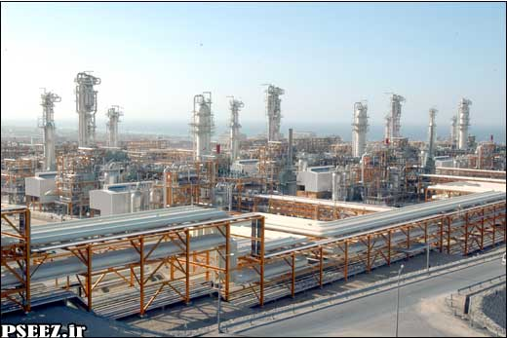
3-4-2. Banking Facilities
3- Main Drivers of the petrochemical Industry in Iran
• Banking regulations at PSEEZ conform to international standards.‎
• Banking transactions with the main land shall be in either IR. Rial or foreign currency of ‎choice, and overseas transactions will be in the respected foreign currency.‎
• Foreign currencies shall not be controlled and the exchange of IR. Rial to any foreign ‎currency is permitted

Slide 18
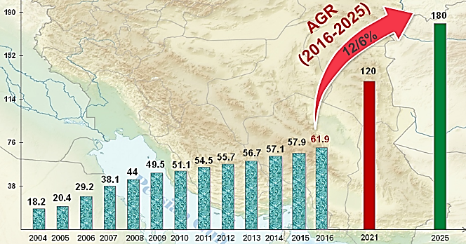
Future projects till 2025
4. Future Projects
Iran’s Petrochemical Capacity Growth through Future Projects
Projects | Nominal Capacity (mn t/y) | Investment (USD$ mn)
Urea & Ammonia | 4.6 | 1540
Olefin & Aromatics | 12 | 5731
Propane DeHydrogenation (PDH) | 1.9 | 1161
GTO, GTPP | 27.9 | 12877
Polymer Projects | 5.1 | 4018
Chemical Projects | 10.6 | 6114
Total | 62.1 | 31,441
Source: NPC
Source: NPC
There are about 46 petrochemical projects targeted for 2025 and expected to cost USD$31.5.
It is estimated that the net annual revenue of the projects to be USD $ 17.8 bn.

Slide 19
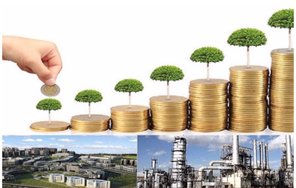
5. Concluding Remarks: 5-1. Why Petrochemicals as an strategic industry in Iran
a. Advantages associated with petrochemical industry in Iran:
Iran’s privileged position in terms of hydrocarbon feedstock, demand potentials as well as access to open waters makes petrochemical industry as an undeniable source of value creation in Iran economy.
b. Contribution of petrochemical industry to Iran economy:
petrochemical industry is regarded as the industrial growth driver in Iran; accounting for 27% of manufacturing value added as well as 48% of manufacturing export revenues.
c. Underutilized opportunities:
despite feedstock advantages and huge investment to petrochemical facilities, still there is rather low terms of trade resulted in Iran’s trade markets. This is mainly due to the high concentration of production and export basket on bulk and low value products.
All mentioned above brings policymakers to the necessity of reconsideration on the way of value chain extension in the industry.

Slide 20
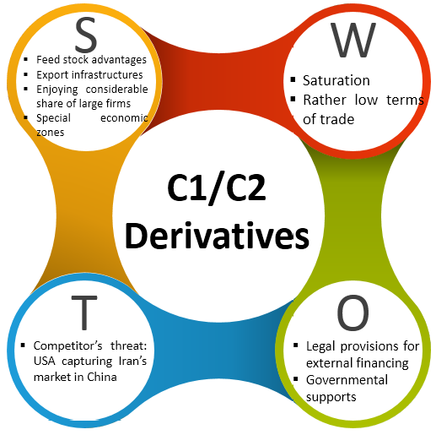
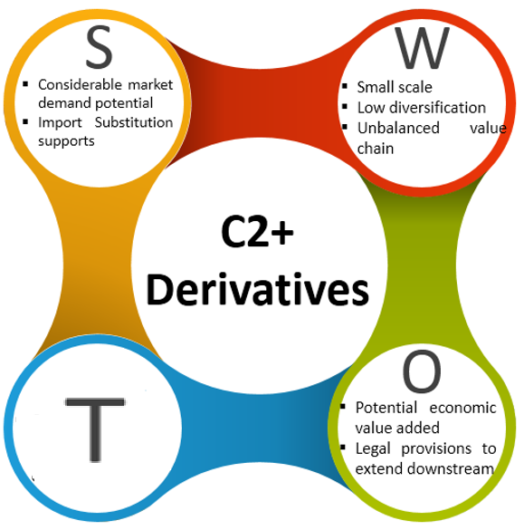
5. Concluding Remarks: 5-2. Future roads: SWOT analysis

Slide 21

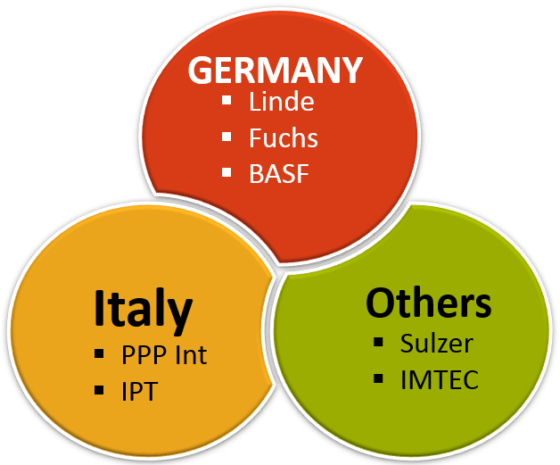
5. Concluding Remarks: 5-3. Fields of priority to promote Joint Ventures:
Transfer of New Technologies
Production of specialty Petrochemical products
Completion of value chains (eg. GTO, GTPP)
Increase the use of Methanol as feedstock in the value chain than exporting it
Deploy domestic know-How & Tech.

Slide 22
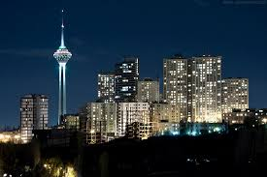
Thank you
a.shafiee@itsr.ir
Industryandmine.itsr@gmail.com
Tehran (2017)

